Slide 1

Lecture 12: Peer Evaluation – Part II
Dr. Tsung-Wei Huang
Department of Electrical and Computer Engineering
University of Utah, Salt Lake City, UT
Notes:
Hello everyone, today we are going to help you go through the team forming process.

Slide 2
Why Should I Care?
Simply inpu, Impact = Users
Many of you already provide feedback to others
Some are sweet
Most are harsh … ☺
No worry, this is typical; the most difficult thing in the world is to convince people to “buy” your idea
This is why it is important to listen to other people’s opinions and use them to refine your idea from time to time
Successful start-up companies often don’t use the original initial ideas
Today, we are going to finish the evaluation for all

Slide 3
Evaluate Your Peer’s Projects
We have opened 10 breakout rooms
Zoom: https://utah.zoom.us/j/2468214418
1-9 are assigned for teams from last week
Thesis track students are in room 10
Working sheet: https://docs.google.com/spreadsheets/d/1JfWZkEyoXdVLtHkiwOqk24G7WVhLWMCP113cSe9fgsQ/edit#gid=547552200
Each group work together to do the following:
Review all other project websites (including thesis track)
Comment on each of the other projects
What is the practical use of this project?
What are the challenges to implement this project?
What is the marketplace for this project?
Will we buy it?
What to improve the project from an outsider’s perspective
Post your comment as a reply to that project’s GitHub post

Slide 4
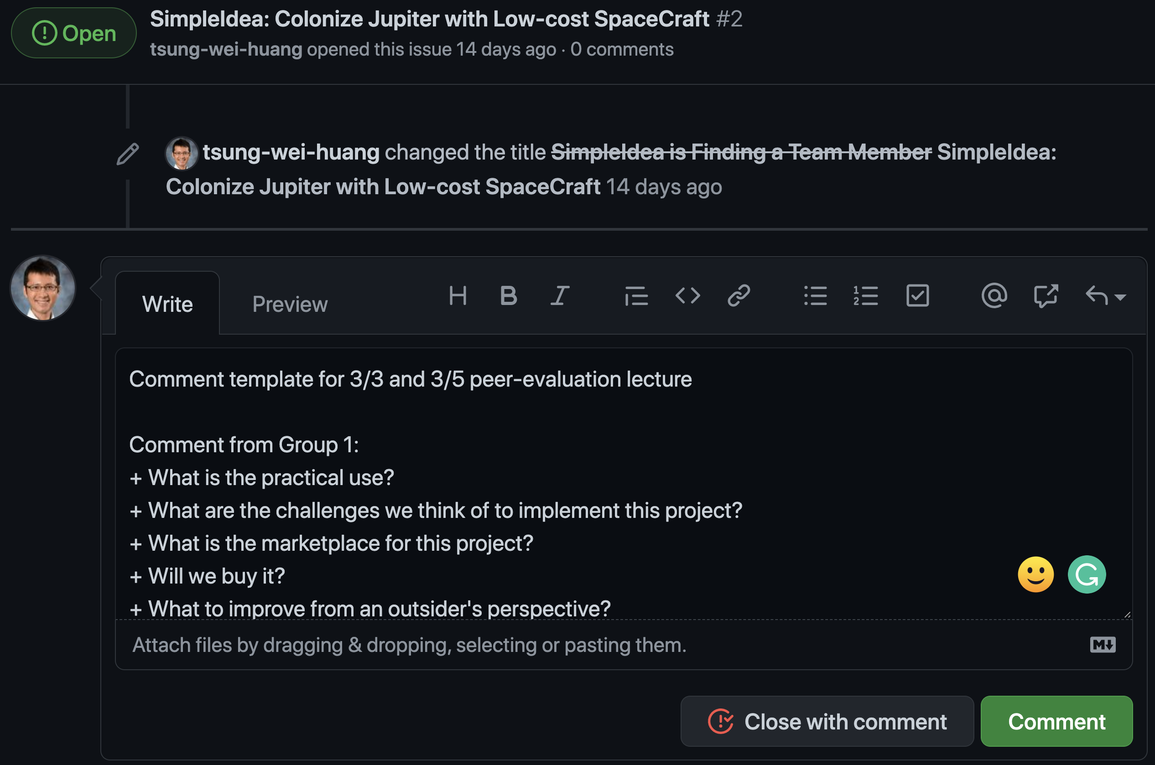
Finish Your Peer Evaluation
Each team spends 5 mins to update your issue page
https://github.com/tsung-wei-huang/cs3992/issues
Include your website in good place others can see
Each team spends the rest to review other projects
Write your comment as a reply to the issue post
Each group needs to review all the other projects (incl. thesis track), except your own projects!!! You can run your review/comments by reading their project website.

